Slide 1
BUG TRACKER
BY Brendan Chukwudi Chukwuemeka (194192)
Computer Engineering department

Slide 2
INTRODUCTION
Issues seem to always arise in finished products or systems, regardless of the resources used in their development.
This project aims to significantly improve the bug tracking and resolution process by:
Properly equipping teams with tools necessary to receive the bugs from customers.
Enabling efficient task and team allocation for each bug in a personalized manner for the customer.
Providing quality-of-life tools to ease team management.

Slide 3
GOALS
There are 3 main goals this project seeks to achieve in creating the bug tracker
Provide the ability for users to directly report bugs and complaints and view the progress of its resolution.
Provide features such as the ability to view problem resolution progress, issue ranking, issue assignment etc. in an easy-to-use interface that simplifies and expedites the process of bug resolution for the team.
Provide team management tools to make the process of creating teams,allocating tasks, communicating between teams, managing projects and managing staff easier.

Slide 4
SOFTWARE AND TOOLS
Flutter framework: Open source framework developed by Google, used for creating cross platform applications. I will be using it due to its extensive capabilities, documentation and developer community.
Android Studio: My IDE of choice as it is the official IDE for flutter
MySQL: My database management system of choice due to its ease of use, ability to handle complex queries and simple integration with flutter applications.
Git/GitHub Desktop: I will be using git for version control and GitHub desktop for easier handling of git actions.

Slide 5
METHOD
Project Management:
• Admins can add new projects and then share the project ID publicly.
• Customers can sign up and reference their project of concern in their bug report using its publicly released ID.
Bug Tracking and Resolution:
• Admins can view reported bugs, form teams, and assign tasks for each bug.
• The team lead for each bug can update the customer, ensuring greater personalization.
• Customers can track the status of their reports as they progress through the resolution process ensuring transparency
Team Coordination:
• Staff can transfer tasks between each other seamlessly.
Additional Features:
• A calendar for adding events.
• A chat application for staff-to-staff interaction.
• Time tracking for tasks

Slide 6
USER INTERFACE
The user interface was inspired by Zoho Bug tracker and as such they follow the same black and orange theme.
I have tried to make the UI as intuitive and accessible as possible, with tooltips when necessary and adaptive layout.
The UI is different for STAFF AND USER
The Staff UI has similarities between Admin Staff and “Normal” Staff
Error messages are included when necessary
There are also notifications and feedback for every action so the user is never confused on what is happening.

Slide 7
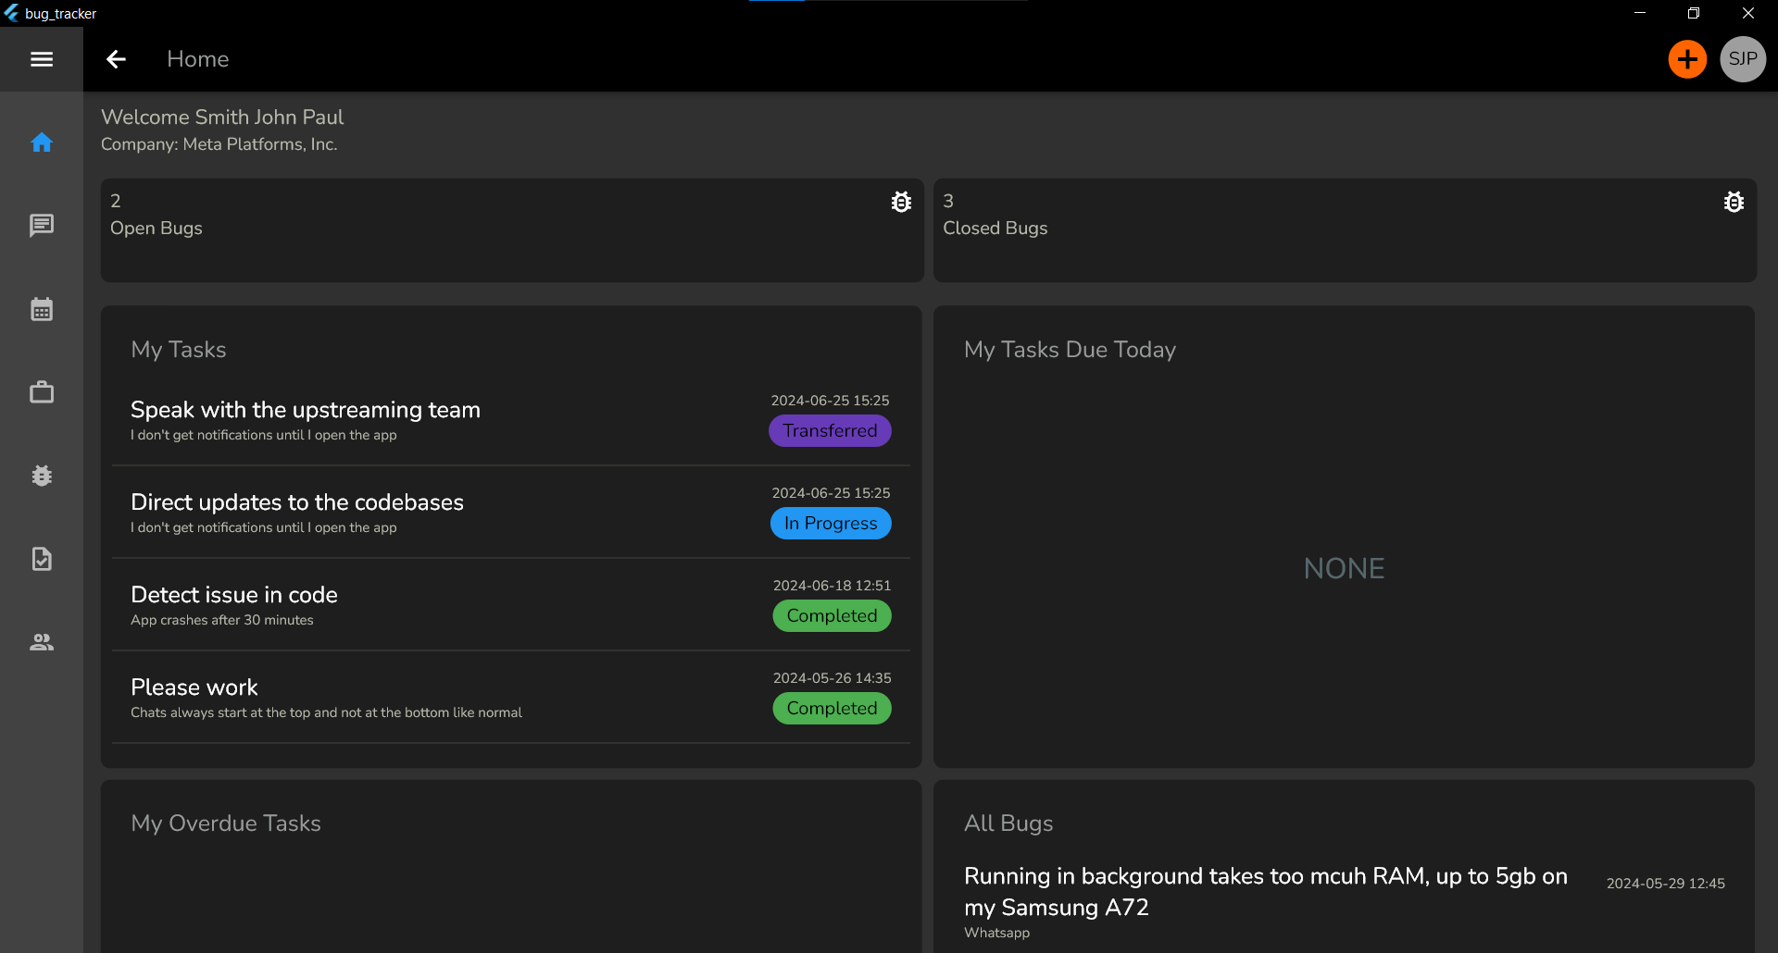
UI SAMPLE: ADMIN HOME PAGE

Slide 8
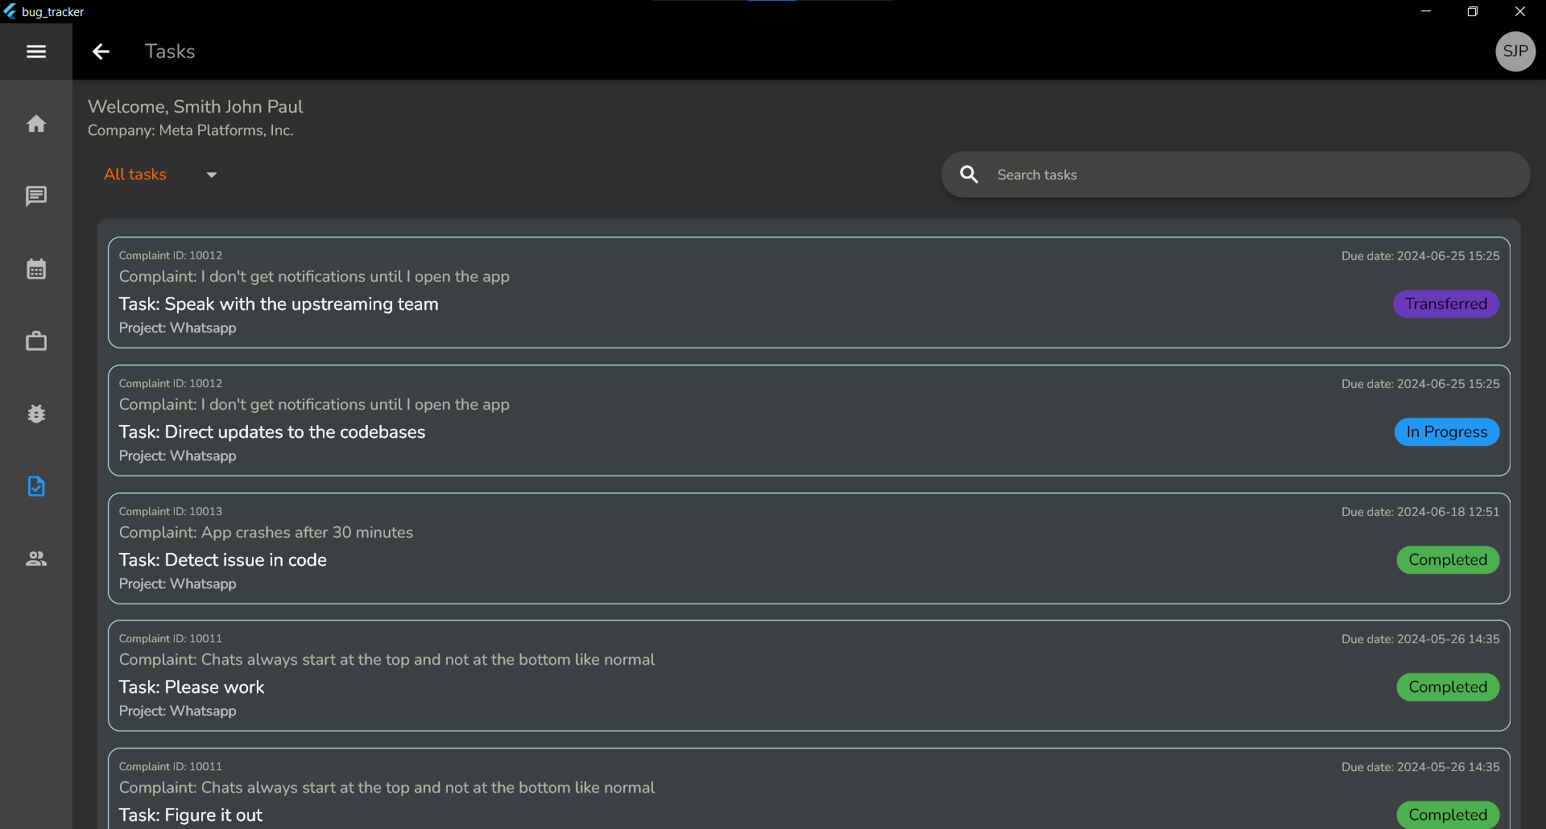
UI SAMPLE: Tasks Page

Slide 9
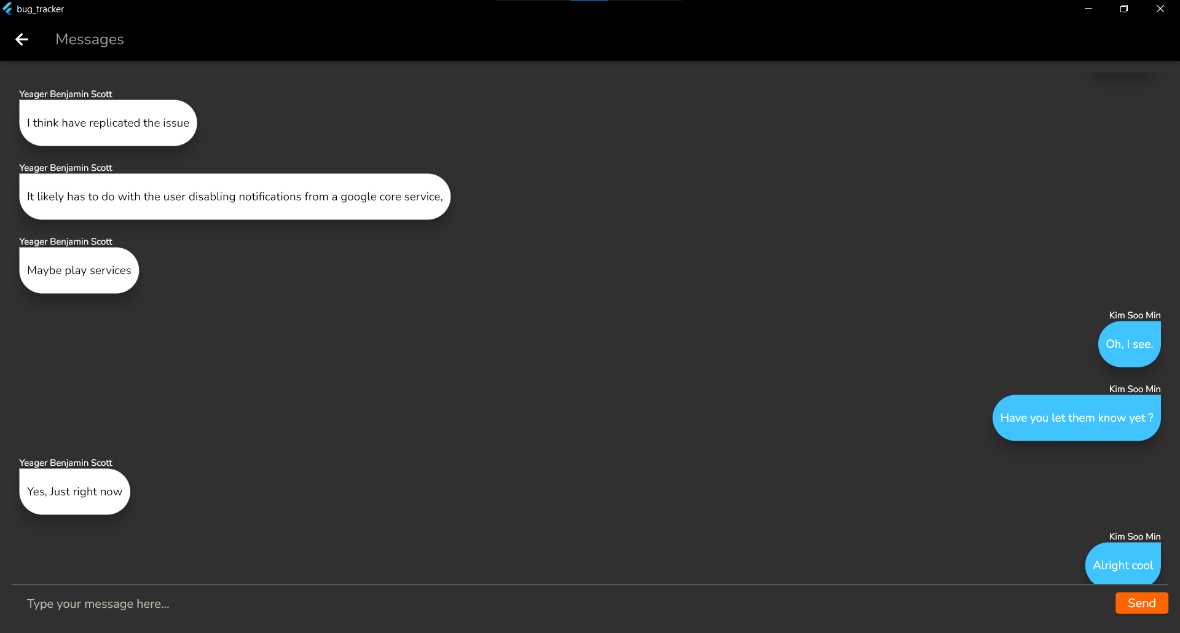
UI SAMPLE: MESSAGES PAGE

Slide 10
UI SAMPLE: TIME TRACKING IN ACTION

Slide 11
OVERALL LOGIC FLOW
ADDITION LOGIC
The actor initiates a task regarding addition to the database
A MySQL query is run
If the query is successful the user is notified if the query fails the user is also informed
Any pages depending on that action is refreshed
RETRIEVAL LOGIC
Pages requiring retrieval of data call the appropriate function asynchronously.
The FutureBuilder flutter component is used which is able to defer building UI until an asynchronous function is completed.
The data retrieved from the database is then “processed” into classes
The classes are then used to build the UI

Slide 12
Database design
The database consists of 13 tables
User Table
Staff Table
Project Table
Calendar events Table
Files Table
Complaint Table
Tags Table
Staff notes Table
Conversations Table
Messages Table
Conversation Participants Table
Task Table
Work sessions Table

Slide 13
CONCLUSION
The range of features provided by this project should be of great assistance to any team looking for a bug tracking application
A few things regarding future improvements
In the future I plan on adding more features as well as improving existing ones, for example:
Artificial Intelligence: An artificial intelligence (AI) agent serving as a first point of contact for reporters in case of trivial or easy to solve reports
Scalability Improvements: Optimizing the database and data representation in the UI to handle larger volumes of bug reports, ensuring it remains efficient as the user base grows.
Advanced Analytics: Advanced analytics for deeper insights into the data; including staff productivity and insights on recurring issues.
Spam protection: Currently there is no way to prevent mass reporting by users either acting in bad spirit or as a result of an error; I plan on adding such a system

